Slide 1
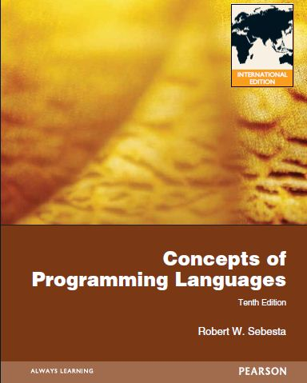
Chapter 1
Preliminaries

Slide 2
Chapter 1 Topics
Reasons for Studying Concepts of Programming Languages
Programming Domains
Language Evaluation Criteria
Influences on Language Design
Language Categories
Language Design Trade-Offs
Implementation Methods
Programming Environments
Copyright © 2012 Addison-Wesley. All rights reserved.
1-<number>

Slide 3
Reasons for Studying Concepts of Programming Languages
Increased ability to express ideas
Improved background for choosing appropriate languages
Increased ability to learn new languages
Better understanding of significance of implementation
Better use of languages that are already known
Overall advancement of computing
Copyright © 2012 Addison-Wesley. All rights reserved.
1-<number>

Slide 4
Programming Domains
Scientific applications
  Large numbers of floating point computations; use of arrays
  Fortran
Business applications
  Produce reports, use decimal numbers and characters
  COBOL
Artificial intelligence
  Symbols rather than numbers manipulated; use of linked lists
  LISP
Systems programming
  Need efficiency because of continuous use
  C
Web Software
  Eclectic collection of languages: markup (e.g., HTML), scripting (e.g., PHP), general-purpose (e.g., Java)
Copyright © 2012 Addison-Wesley. All rights reserved.
1-<number>

Slide 5
Language Evaluation Criteria
Readability: the ease with which programs can be read and understood
Writability: the ease with which a language can be used to create programs
Reliability: conformance to specifications (i.e., performs to its specifications)
Cost: the ultimate total cost
Copyright © 2012 Addison-Wesley. All rights reserved.
1-<number>

Slide 6
Evaluation Criteria: Readability
Overall simplicity
  A manageable set of features and constructs
  Minimal feature multiplicity
  Minimal operator overloading
Orthogonality
  A relatively small set of primitive constructs can be combined in a relatively small number of ways
  Every possible combination is legal
Data types
  Adequate predefined data types
Syntax considerations
  Identifier forms: flexible composition
  Special words and methods of forming compound statements
  Form and meaning: self-descriptive constructs, meaningful keywords
Copyright © 2012 Addison-Wesley. All rights reserved.
1-<number>

Slide 7
Evaluation Criteria: Writability
Simplicity and orthogonality
  Few constructs, a small number of primitives, a small set of rules for combining them
Support for abstraction
  The ability to define and use complex structures or operations in ways that allow details to be ignored
Expressivity
  A set of relatively convenient ways of specifying operations
  Strength and number of operators and predefined functions
Copyright © 2012 Addison-Wesley. All rights reserved.
1-<number>

Slide 8
Evaluation Criteria: Reliability
Type checking
  Testing for type errors
Exception handling
  Intercept run-time errors and take corrective measures
Aliasing
  Presence of two or more distinct referencing methods for the same memory location
Readability and writability
  A language that does not support “natural” ways of expressing an algorithm will require the use of “unnatural” approaches, and hence reduced reliability
Copyright © 2012 Addison-Wesley. All rights reserved.
1-<number>

Slide 9
Evaluation Criteria: Cost
Training programmers to use the language
Writing programs (closeness to particular applications)
Compiling programs
Executing programs
Language implementation system: availability of free compilers
Reliability: poor reliability leads to high costs
Maintaining programs
Copyright © 2012 Addison-Wesley. All rights reserved.
1-<number>

Slide 10
Evaluation Criteria: Others
Portability
  The ease with which programs can be moved from one implementation to another
Generality
  The applicability to a wide range of applications
Well-definedness
  The completeness and precision of the language’s official definition
Copyright © 2012 Addison-Wesley. All rights reserved.
1-<number>

Slide 11
Influences on Language Design
Computer Architecture
  Languages are developed around the prevalent computer architecture, known as the von Neumann architecture
Program Design Methodologies
  New software development methodologies (e.g., object-oriented software development) led to new programming paradigms and by extension, new programming languages
Copyright © 2012 Addison-Wesley. All rights reserved.
1-<number>

Slide 12
Computer Architecture Influence
Well-known computer architecture: Von Neumann
Imperative languages, most dominant, because of von Neumann computers
  Data and programs stored in memory
  Memory is separate from CPU
  Instructions and data are piped from memory to CPU
  Basis for imperative languages
    Variables model memory cells
    Assignment statements model piping
    Iteration is efficient
Copyright © 2012 Addison-Wesley. All rights reserved.
1-<number>

Slide 13

The von Neumann Architecture
Copyright © 2012 Addison-Wesley. All rights reserved.
1-<number>

Slide 14
The von Neumann Architecture
Fetch-execute-cycle (on a von Neumann architecture computer)
  initialize the program counter
  repeat forever
  fetch the instruction pointed by the counter
  increment the counter
  decode the instruction
  execute the instruction
  end repeat
Copyright © 2012 Addison-Wesley. All rights reserved.
1-<number>

Slide 15
Programming Methodologies Influences
1950s and early 1960s: Simple applications; worry about machine efficiency
Late 1960s: People efficiency became important; readability, better control structures
  structured programming
  top-down design and step-wise refinement
Late 1970s: Process-oriented to data-oriented
  data abstraction
Middle 1980s: Object-oriented programming
  Data abstraction + inheritance + polymorphism
Copyright © 2012 Addison-Wesley. All rights reserved.
1-<number>

Slide 16
Language Categories
Imperative
  Central features are variables, assignment statements, and iteration
  Include languages that support object-oriented programming
  Include scripting languages
  Include the visual languages
  Examples: C, Java, Perl, JavaScript, Visual BASIC .NET, C++
Functional
  Main means of making computations is by applying functions to given parameters
  Examples: LISP, Scheme, ML, F#
Logic
  Rule-based (rules are specified in no particular order)
  Example: Prolog
Markup/programming hybrid
  Markup languages extended to support some programming
  Examples: JSTL, XSLT
Copyright © 2012 Addison-Wesley. All rights reserved.
1-<number>

Slide 17
Language Design Trade-Offs
Reliability vs. cost of execution
  Example: Java demands all references to array elements be checked for proper indexing, which leads to increased execution costs
Readability vs. writability
  Example: APL provides many powerful operators (and a large number of new symbols), allowing complex computations to be written in a compact program but at the cost of poor readability
Writability (flexibility) vs. reliability
  Example: C++ pointers are powerful and very flexible but are unreliable
Copyright © 2012 Addison-Wesley. All rights reserved.
1-<number>

Slide 18
Implementation Methods
Compilation
  Programs are translated into machine language; includes JIT systems
  Use: Large commercial applications
Pure Interpretation
  Programs are interpreted by another program known as an interpreter
  Use: Small programs or when efficiency is not an issue
Hybrid Implementation Systems
  A compromise between compilers and pure interpreters
  Use: Small and medium systems when efficiency is not the first concern
Copyright © 2012 Addison-Wesley. All rights reserved.
1-<number>

Slide 19

Layered View of Computer
The operating system and language implementation are layered over
machine interface of a computer
Copyright © 2012 Addison-Wesley. All rights reserved.
1-<number>

Slide 20
Compilation
Translate high-level program (source language) into machine code (machine language)
Slow translation, fast execution
Compilation process has several phases:
  lexical analysis: converts characters in the source program into lexical units
  syntax analysis: transforms lexical units into parse trees which represent the syntactic structure of program
  Semantics analysis: generate intermediate code
  code generation: machine code is generated
Copyright © 2012 Addison-Wesley. All rights reserved.
1-<number>

Slide 21

The Compilation Process
Copyright © 2012 Addison-Wesley. All rights reserved.
1-<number>

Slide 22
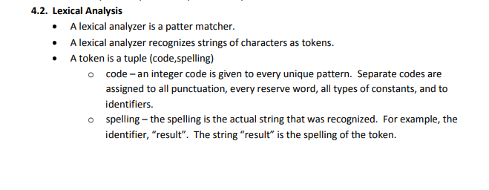
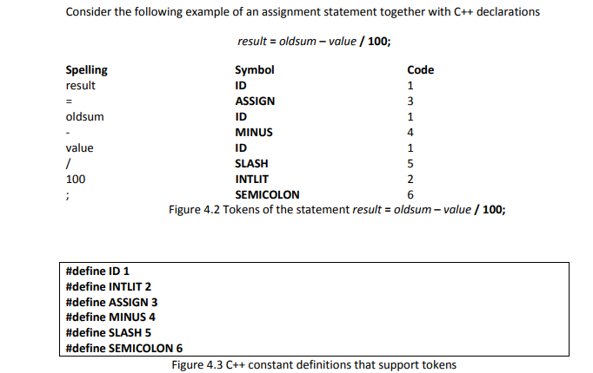
Lexical Analysis
Copyright © 2012 Addison-Wesley. All rights reserved.
1-<number>

Slide 23
Additional Compilation Terminologies
Load module (executable image): the user and system code together
Linking and loading: the process of collecting system program units and linking them to a user program
Copyright © 2012 Addison-Wesley. All rights reserved.
1-<number>

Slide 24
Von Neumann Bottleneck
Connection speed between a computer’s memory and its processor determines the speed of a computer
Program instructions often can be executed much faster than the speed of the connection; the connection speed thus results in a bottleneck
Known as the von Neumann bottleneck; it is the primary limiting factor in the speed of computers
Copyright © 2012 Addison-Wesley. All rights reserved.
1-<number>

Slide 25
Pure Interpretation
No translation
Easier implementation of programs (run-time errors can easily and immediately be displayed)
Slower execution (10 to 100 times slower than compiled programs)
Often requires more space
Now rare for traditional high-level languages
Significant comeback with some Web scripting languages (e.g., JavaScript, PHP)
Copyright © 2012 Addison-Wesley. All rights reserved.
1-<number>

Slide 26

Pure Interpretation Process
Copyright © 2012 Addison-Wesley. All rights reserved.
1-<number>

Slide 27
Hybrid Implementation Systems
A compromise between compilers and pure interpreters
A high-level language program is translated to an intermediate language that allows easy interpretation
Faster than pure interpretation
Examples
  Perl programs are partially compiled to detect errors before interpretation
  Initial implementations of Java were hybrid; the intermediate form, byte code, provides portability to any machine that has a byte code interpreter and a run-time system (together, these are called Java Virtual Machine)
Copyright © 2012 Addison-Wesley. All rights reserved.
1-<number>

Slide 28

Hybrid Implementation Process
Copyright © 2012 Addison-Wesley. All rights reserved.
1-<number>

Slide 29
Just-in-Time Implementation Systems
Initially translate programs to an intermediate language
Then compile the intermediate language of the subprograms into machine code when they are called
Machine code version is kept for subsequent calls
JIT systems are widely used for Java programs
.NET languages are implemented with a JIT system
In essence, JIT systems are delayed compilers
Copyright © 2012 Addison-Wesley. All rights reserved.
1-<number>

Slide 30
Preprocessors
Preprocessor macros (instructions) are commonly used to specify that code from another file is to be included
A preprocessor processes a program immediately before the program is compiled to expand embedded preprocessor macros
A well-known example: C preprocessor
  expands #include, #define, and similar macros
Copyright © 2012 Addison-Wesley. All rights reserved.
1-<number>

Slide 31
Programming Environments
A collection of tools used in software development
UNIX
  An older operating system and tool collection
  Nowadays often used through a GUI (e.g., CDE, KDE, or GNOME) that runs on top of UNIX
Microsoft Visual Studio.NET
  A large, complex visual environment
Used to build Web applications and non-Web applications in any .NET language
NetBeans
  Related to Visual Studio .NET, except for applications in Java
Copyright © 2012 Addison-Wesley. All rights reserved.
1-<number>

Slide 32
Summary
The study of programming languages is valuable for a number of reasons:
  Increase our capacity to use different constructs
  Enable us to choose languages more intelligently
  Makes learning new languages easier
Most important criteria for evaluating programming languages include:
  Readability, writability, reliability, cost
Major influences on language design have been machine architecture and software development methodologies
The major methods of implementing programming languages are: compilation, pure interpretation, and hybrid implementation
Copyright © 2012 Addison-Wesley. All rights reserved.
1-<number>

